Slide 1
Research on Stock Earning Impact
FRE-GY 6883 Financial Computing Team Project
Murray Wang
Zhuoran Ma
Yiyao Li
Lulin Wang
Qinkai Yang
Kaiyun Kang
2022/05/11

Slide 2
Summary
In this project, our team investigated the relationship between Russell 3000 stocks’ earning surprise percentage and their CAAR (Cumulative Average Abnormal Return) based on IWV benchmark before and after the earning announcement date.
We divided all Russell 3000 stocks equally into 3 groups (beat, meet and miss) according to their earning surprise percentage and implemented bootstrapping 40 times with batch size 80 to all 3 groups. We found that in general, stocks with higher surprise percentage would have higher CAAR after earning announcement date.
Notes:
In this project, we divide the Russell 3000 stocks into 3 groups according to their earning surprise percentage and do the bootstrap to calculate the average AAR and CAAR based on IWV benchmark. We found that in general, stocks with higher surprise percentage would have higher CAAR after earning announcement date.

Slide 3
Task Allocation
Murray Wang: Implement menu, group stocks, multithreading retrieve data
Zhouran Ma: Multithreading retrieve data, create Benchmark classes
Yiyao Li: Calculate and pull data of individual stock, create class Stock
Lulin Wang: Implementation of bootstrapping, created relative classes
Qinkai Yang: Create class Vector, class Onecalcul, class SampleCalcul
Kaiyun Kang: Plot average CAARs using Gnuplot and make conclusions

Slide 4
Project Design Diagrams
P A R T 0 1

Slide 5
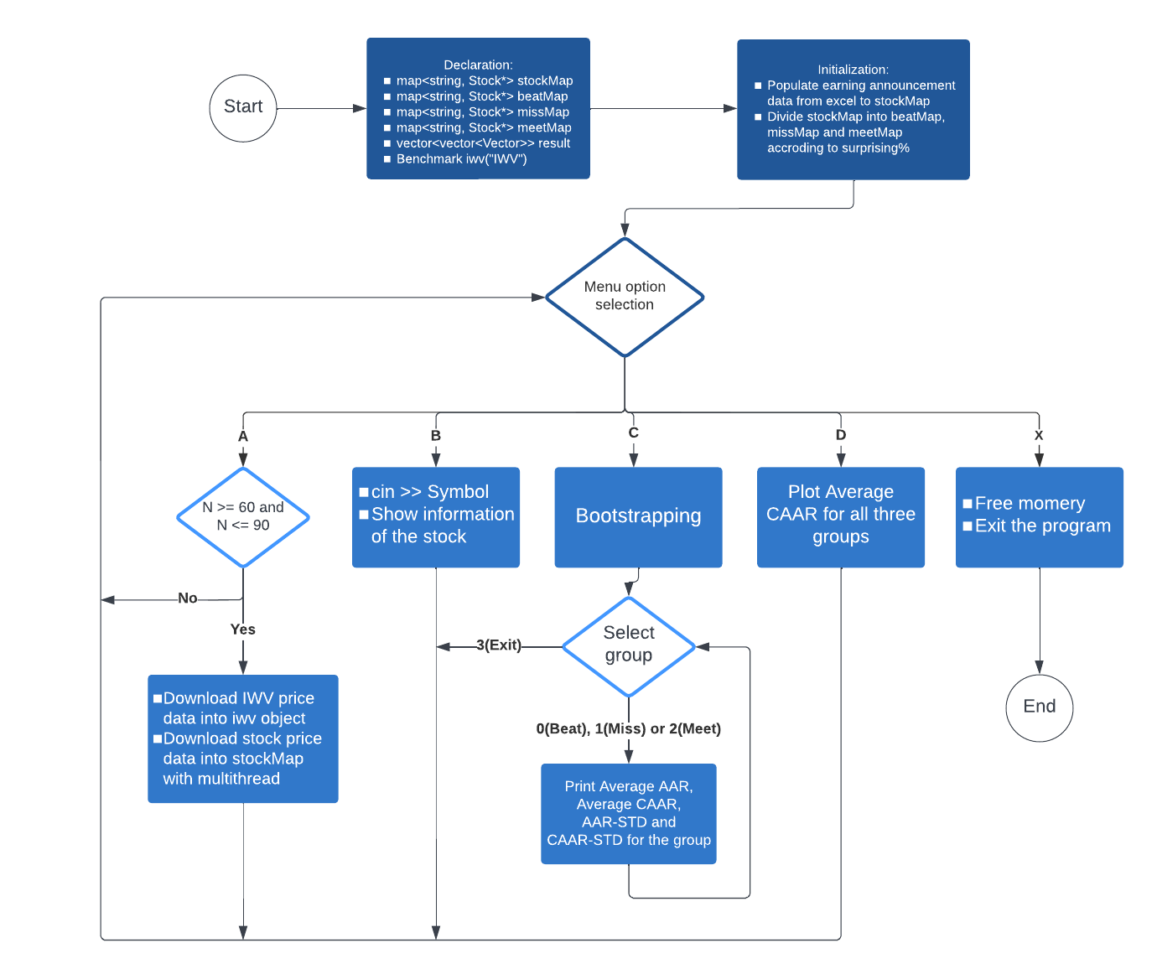
P A R T 0 1
Flow Chart
Notes:
First I will introduce our project design. As the program start, we first declare a stockMap to store all the stock data. The key is the stock symbol and the value is the stock pointer. We also declare beatMap, missMap and meetMap to store stock pointers for different groups. We also declare a benchmark object IWV to store the index price data. After that, we populate the earning announcement data from excel to stock objects and do the stocks grouping. I’ll explain later how we do the grouping. Then we get to the menu. The menu has 5 options. Option A is downloading data. We download the IWV data first with a fixed time period, and then we use multithread to download stocks data. We use dates in IWV to find the start date and end date when we download data for each stock. Option B is user entering a valid stock symbol and the program will calculate the daily return and AAR for that stock and show all the information of the stock. Option C is doing bootstrapping and show the average AAR, CAAR, AAR std and CAAR std for each group. Option D is to plot the average CAAR for all groups and Option X is to exit the program.

Slide 6
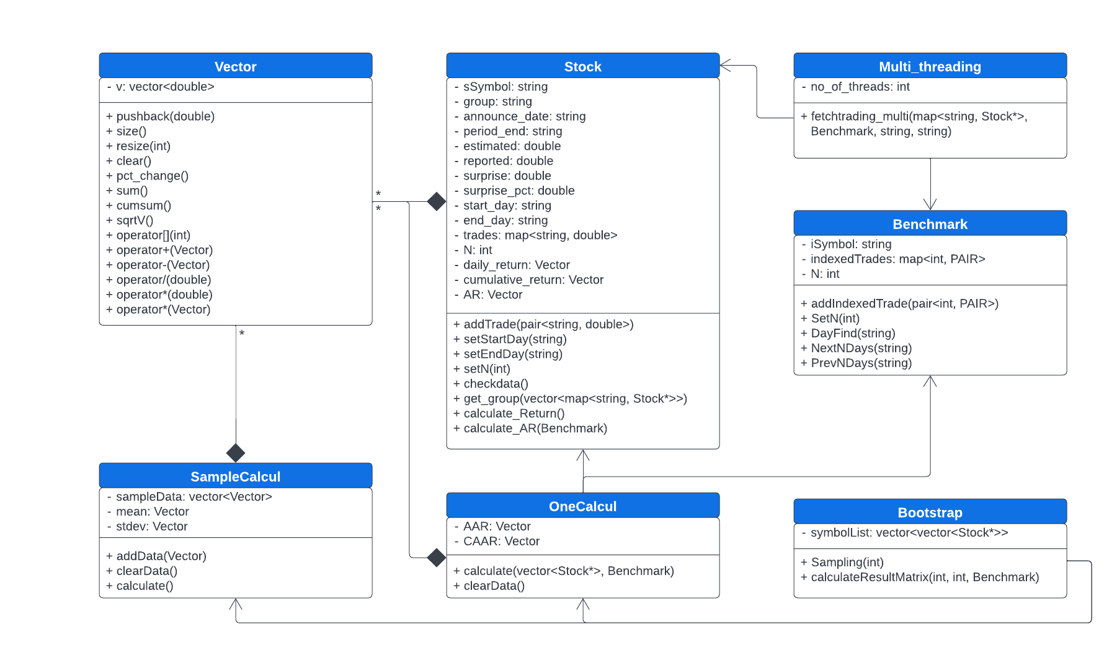
P A R T 0 1
Class UML Diagram
Notes:
This is our UML disgram. We can see Vector is our most basic class and here the solid diamond means it is data members belong to Stock, SampleCalcul, and Onecalcul classes, and the relationship is one to many. We use Stock and Benchmark classes to store all data of stocks and index. The Multi_threading class need to invoke Stock and Benchmark to download data, Onecalcul need to invoke Stock and Benchmark to calculate AR and CAAR. Finally, Bootstrap class invoke Onecalcul and Samplecalcul classes to get the result.

Slide 7
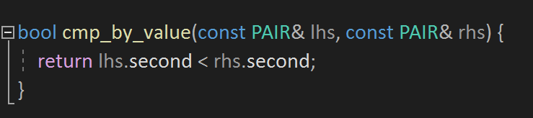
P A R T 0 1
Group Selected Stocks
We created three individual map containers to group stock pointers.
We used vector<pair<string, double>> stockSurp to realize the sorting according to surprise% since map is always sorted by keys.
Function defining the sorting rule
Sorting symbols by surprise% in ascending order
We created map<string, Stock*> beatMap, meetMap, missMap based on stockSurp and stockMap.
Notes:
This is how we group stocks. We know map is always sorted by keys so we cannot directly sort the stockMap according to surprise%. What we do is we create a vector of pairs called stockSurp. The first value of the pair stores the symbol and the second value stores the surprise%. We then create a comparison function to define the sorting rule and sort the vector using the function. Finally we can group stocks into our three maps according to the sorted vector stockSurp.

Slide 8
Class declaration
&
Data structures
P A R T 0 2

Slide 9
P A R T 0 2
Class: Benchmark
Data and Function related to benchmark
Typedef pair<string, double> PAIR
Private Data:
User defined data type to store pair of ticker and surprise %
String iSymbol
map <int, PAIR> indexedTrades
int N
Store the benchmark data in the map
Public Member Function:
getSymbol( )
getIndexedTrades( )
getN( )
addIndexedTtade( )
DayFind( )
NextNDays( )
PrevNDays( )
Get private data
Some firms release report on weekends (eg: CE, ON), so we will need to adjust the day0 to next trading day.
Find for the previous N days before the announcement date and Next N days after the announcement date

Slide 10
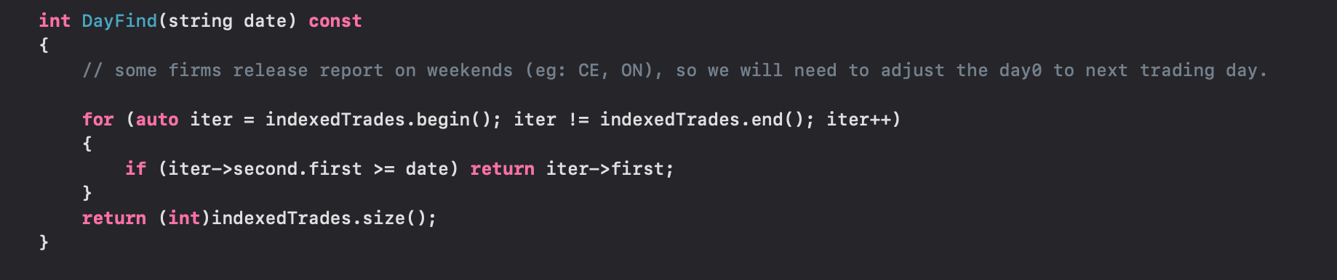
P A R T 0 2
Class Benchmark: DayFind( )
Used to adjust day0 if the announcement date is in the weekend
Go through the iterator to check whether we need to adjust date

Slide 11
Class Muti_threading: Retrieve price data
P A R T 0 2
int no_of_threads;
void fetchtrading_multi(map<string, Stock*>& stockMap, const Benchmark& benchmark, const string &url_common, const string &api_token)
01
Populate startday, endday, N using benchmark.PrevNDays(annouceday), NextNDays, GetN()
Record the stock symbols in stockTickers in the same order as stockMap
stockmap
vector<string> stockTickers
02
sub_stockmap_list store all sliced stock map
threads.emplace_back(thread(fetchtrading, ref(sub_stockMap_list[i]), url_common, api_token))
vector<map<string, Stock*>> sub_stockMap_list;
vector<thread> threads;

Slide 12
Single Thread
P A R T 0 2
int fetchtrading(map<string, Stock*>& stockMap, string url_common, string api_token)
Iterate over stockmap
Get startday/endday from stock pointer
Use Libcurl to fetch data and store in the stock object
iter->second->addTrade(make_pair(sDate, dValue));
iter->second->addTrade(make_pair(sDate, dValue));
warning for stocks with less than 2N+1 price data
if (iter->second->getTrades().size() != 2 * iter->second-> getN() + 1) {
cout << iter->first << '\t' << iter->second->getTrades().size() << endl;

Slide 13
Class: Stock
Pull information for one stock from one group
Private Data:
Symbol
Group
Announce_date
Period_end
estimated
reported
surprise
surprise_pct
start_day
end_day
map<string, double> trades
Vector daily_return
Vector cumulative_return
Vector AR
Store stock data in the map. Key is the trading date, and value is the daily price
User-defined data type Vector: to store
vector <double>
Public Member function:
getSymbol( )
getAnnounceDay( )
…….
Vector getReturn( )
Vector getCumulativeReturn( )
Vector getAR( )
……
……
ostream& operator<<(ostream& ostr, const Stock& stock)
Get Private data
Overload cout to get stock information

Slide 14
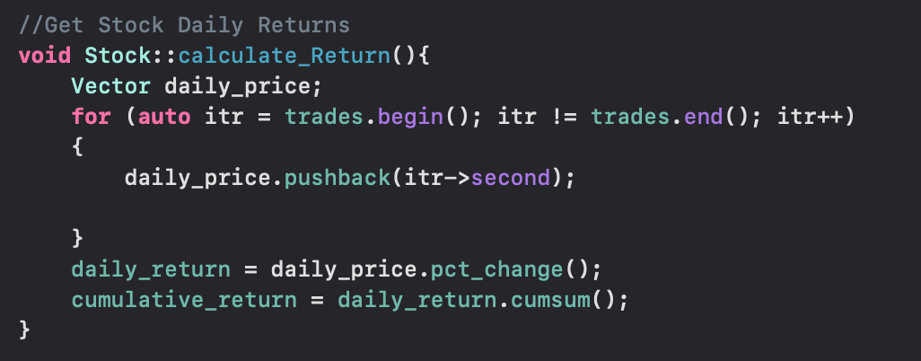
P A R T 0 2
Class Stock: Calculate_Return( )
Use our own Vector class to store daily price
We use some Vector calculation function inside the class Vector to calculate the percentage change and cumulative return

Slide 15
Class Vector
P A R T 0 2
Compared with STL vector, the Vector class stores a vector<double>.
It has some extended advanced vector calculation functions.
For example:
Vector pct_change()const; // percentage change can be used to calculate the daily return
Vector cumsum()const; // cumulative sum can be used to calculate the CAAR
We also did operator overloading for common vector calculations (+, -, *, /)

Slide 16
Class Stock: Calculate_AR( )
P A R T 0 2
Vector calculate_AR(const Benchmark& benchmark);
This member function returns the Abnormal Return vector of the stock.
How it works:
Step 1: Get the daily price and then calculate the daily return of IWV of the
corresponding time period
Step 2: Calculate the Abnormal Return
AR = daily_return - iwvReturn;
return AR;
Vector iwvPrice;
Vector iwvReturn = iwvPrice.pct_change();

Slide 17
Class OneCalcul
P A R T 0 2
Use this class to calculate the AAR and CAAR of a group of stocks.
Structure of this class:
Vector AAR;
Vector CAAR;
void calculate(vector<Stock*> stockList, const Benchmark& iwv);
Given a vector of pointers to stock objects in a group and the benchmark, this function will calculate the AAR and CAAR of this stock group and store the result in Vevtor AAR and Vector CAAR.

Slide 18
Class SampleCalcul
P A R T 0 2
Used to store the result of AARs or CAARs of 40 sampling of 1 group and calculate mean & std
Private data member:
vector<Vector> sampleData
Vector mean
Vector stdev
Store AAR(CAAR) of 40 sampling
Public member function:
addData(Vector v)
calculate()
getMean()
getStd()
Called after each sampling to store results
Called after all the sampling to use sampleData to calculate Ave AAR(CAAR) & AAR std(CAAR std) and store in mean & stdev
Return mean(stdev)
Notes:
Class SampleCalcul is used to store the result of AAR or CAAR of 1 group after each sampling and calculate the mean and standard deviation after 40 sampling. So when doing Bootstrap, we will create 6 objects of this class in total, 2 for each group. It has 3 private data members. sampleData is used to store AAR or CAAR of the 40 samples. To update it the member function addData will be called after each sampling. The other two data members are used to store the results of mean and standard deviation. They will be updated by calling the member function calculate after sampleData contains all the results of 40 sampling.

Slide 19
Class Bootstrap
P A R T 0 2
Used to generate random number to do the sampling and calculate result matrix of 3 group
Private data member:
vector<vector<Stock*>> symbolList
Store all the stock pointers that have enough data
symbolList.size() = 3
symbolList[i].size() = num of stocks with enough data in each group
Public member function:
constructor with a parameter (parameter: vector of map of 3 group)
Set seed for random number generator
go through 3 map & store pointer into symbolList
Notes:
Class Bootstrap is used to generate samples and calculate the result matrix required by option C of the menu. It includes a vector of vector of stock pointer as private data member, which will be used in sampling. And this class only has one constructor. It means the object of this class can only be constructed by passing a vector of maps of 3 groups in. The constructor has two goals. First it will set the seed for the random number generator. Second it will convert the maps of stock symbols and pointers to vectors of pointers while removing stocks without enough data. We convert map to vector because then when sampling we can use random integers as index of vector and get vectors of pointers directly, instead of getting a vector of stock symbols first and then going to maps to get the stock pointer.

Slide 20
Class Bootstrap
P A R T 0 2
Public member function:
vector<vector<Stock*>> Sampling(int size)
Generate a sample for 3 group
size: num of sample, in this project 80
Use while loop to ensure 80 different stocks for each group
Size of return: 3x80
vector<vector<Vector>> calculateResultMatrix(int size, int times, const Benchmark& iwv)
size: used when calling the function Sampling
times: times of sampling, in this project 40
1) do the sampling, call the member function of class OneCalcul to get AAR & CAAR and store.
2) call the member function of class SampleCalcul to calculate and store the result
Size of return: 3x4x2N
Notes:
Member function Sampling is used to generate a sample for 3 groups at once. In other words, it will return a vector containing 3 elements, and each element is a vector of stock pointer, with size equal to the parameter of the function, in this case, 80. It first uses a for loop to generate a sample for each group. Then in each loop it uses a while loop to get 80 different integers. These integers will be used as index to get the pointer of stock object. And the member function calculateResultMatrix will complete the whole process of Bootstrap algorithm and get the result matrix. The parameter size is the same meaning as in function Sampling. And the parameter times is how many times we do the sampling. In this function, after all the local variables needed are created, first the member function Sampling is called. And then the member function calculate of the object of class OneCalcul is called to calculate AAR and CAAR. We store AAR and CAAR of each group into the objects of class SampleCalcul respectively. After 40 times of sampling we call the member function calculate in class SampleCalcul to get the means and standard deviations of AAR and CAAR of each group and finally store them into the result matrix.

Slide 21
Visualization
&
Gnuplot
P A R T 0 3

Slide 22
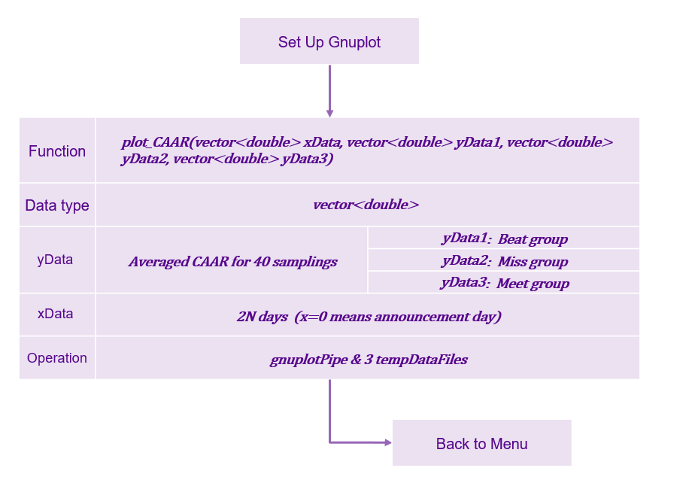
Gnuplot - Averaged CAAR for Beat, Meet, Miss Groups
P A R T 0 3

Slide 23
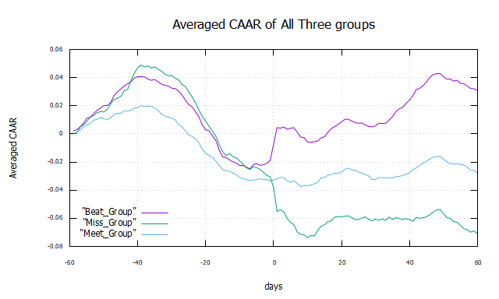
Gnuplot - Averaged CAAR for Beat, Meet, Miss Groups
P A R T 0 3

Slide 24
Conclusion
P A R T 04

Slide 25
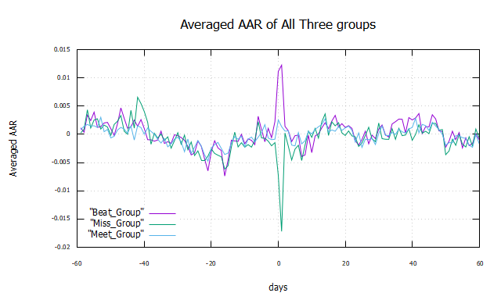
Conclusion
P A R T 0 4
Three groups are sorted by their earnings surprise of 2021 Q2. Earnings reveal the financial health and economic conditions of businesses. An earnings surprise occurs when a company's reported quarterly or annual profits are above or below analysts' expectations. When a company's profit performance fails to match the expectations set by the investment community, investors often express their disappointment by selling shares.
Our group concluded that: earning releases of Russell 3000 stocks have a huge impact on their future stock prices, and stocks with higher surprise will have higher CAAR after earning announcement date. This conclusion can be explained in three aspects from graphs CAAR and AAR as following table:

Slide 26
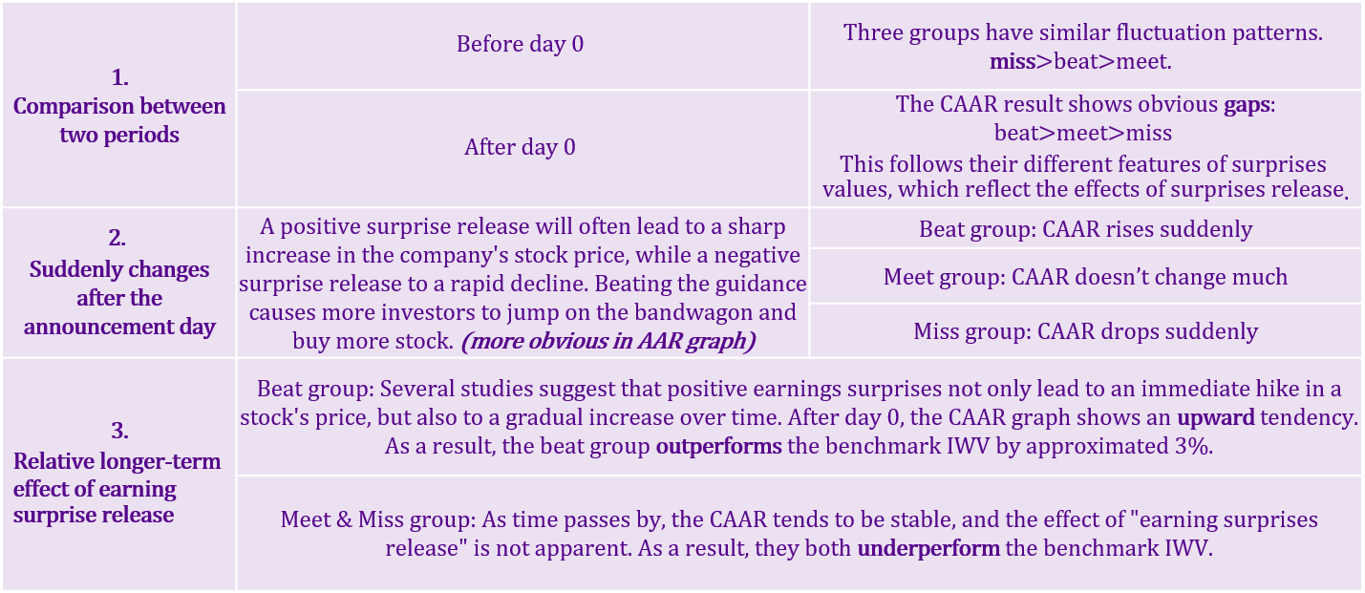
Conclusion
P A R T 0 4

Slide 27
Enhancement
&
Enrichment
P A R T 05

Slide 28
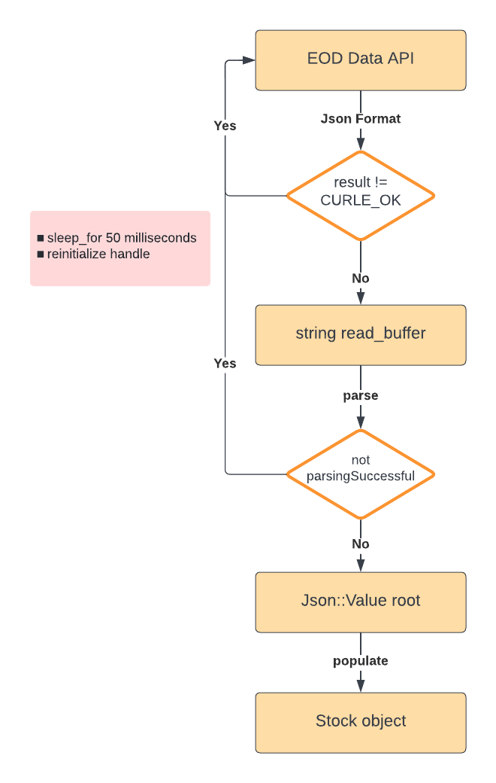
Enhancement & Enrichment
P A R T 0 5
We downloaded json format data from EOD and parsed them into our stock objects for program stability and efficiency.
Fixed issues which might occur when retrieving data from EOD on PC:
Libcurl connection failed
429 Too Many Request error
Notes:
We did an enhancement in downloading data part. Instead of retrieving CSV format data from EOD, we retrieve Json format data which is more versatile and scalable. Actually, we found retrieving CSV format data on PC is not stable. So this is how we download data. There are two potential errors might happen during the process. When we call the curl_easy_perform function, sometimes the connection failed and we need to wait some time and rebuild the connection. If the curl_easy_perform is ok, we get json format data on the real_buffer. When we need to parse the data, sometimes the data cannot be parsed because it contained 429 too many request error. In this case, again we need to wait and reinitialize the handle until we successfully get the true data.

Slide 29
Reference
P A R T 06

Slide 30
Reference
P A R T 0 6
Multithreading in C++:
https://www.geeksforgeeks.org/multithreading-in-cpp/
How Earnings Affect Stock Prices:
https://money.usnews.com/investing/investing-101/articles/how-earnings-affect-stock-prices
The Impact of Earnings Announcements on Stock Prices:
https://finance.zacks.com/impact-earnings-announcements-stock-prices-4265.html
How to Fix 429 Too Many Requests Error:
https://kinsta.com/knowledgebase/429-too-many-requests/

